Slide 1
C++ Notes – BCA – 3rd Semester
Static Keyword

Slide 2
Static Keyword –
What is static keyword?
Static is a keyword in C++ used to give special characteristics to an element.
Static elements are allocated storage only once in a program lifetime in static storage area.
They have a scope till the program lifetime.
In C++, static can be –
Static variable in functions
Static Class Objects
Static member Variable in class
Static Methods in class
Advantages of Static Keyword -
Memory efficient: Now we don't need to create instance for accessing the static members, so it saves memory. Moreover, it belongs to the type, so it will not get memory each time when instance is created.

Slide 3
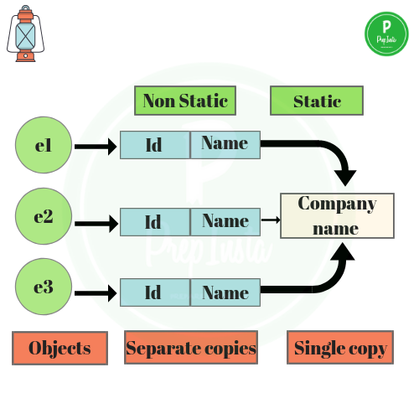

Slide 4
Static Keyword –
Static Field –
A field which is declared as static is called static field.
Unlike instance field which gets memory each time whenever we create object, there is only one copy of static field created in the memory. It is shared to all the objects.
e.g.,
#include<iostream.h>
#include<conio.h>
void main()
{
static int a;
}

Slide 5
Static Keyword –
What are the difference between Field and Variable?
Not all variables are fields.
Local variables of a method are variables, but not fields.
Parameters to a method, property, constructor, or anonymous method are variables, but are not fields.
Not all fields are variables.
e.g., A const member is technically a field, but it is not a variable.

Slide 6
Static Keyword –
Static Method –
A field which is declared as static is called static field.
Unlike instance field which gets memory each time whenever we create object, there is only one copy of static field created in the memory. It is shared to all the objects.
e.g.,
#include<iostream.h>
#include<conio.h>
static void display()
{
cout<<"hello world...!";
}
void main()
{
display();
}

Slide 7
Thank you…!

